Slide 1
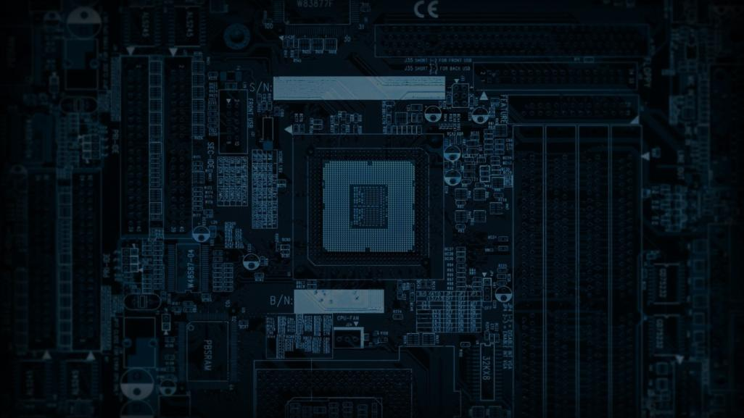




FIC
Sesiunea 3 – S6 – Grupa 2.2
Notes:
https://unsplash.com/photos/AXu2aZ3YgP8

Slide 2

Echipă

Slide 3


Noi suntem..
Carry
Home
Notes:
https://unsplash.com/photos/fItRJ7AHak8

Slide 4
Mai exact..
Notes:
https://unsplash.com/photos/fItRJ7AHak8

Slide 5
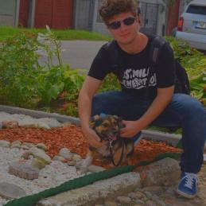
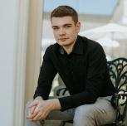
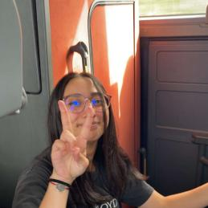
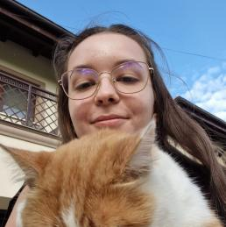

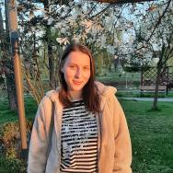
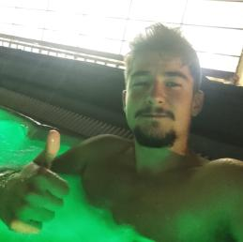

DEVELOPER
DEVELOPER
HW DESIGN
HW DESIGN
PROJECT MANAGER
TESTING & QA+UX
DEVELOPER
DEVELOPER
DEVELOPER
Efrem Dragoș-Sebastian-Mihaly

Slide 6
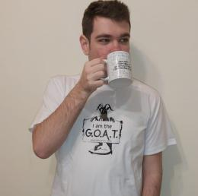

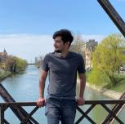
DEVELOPER
DEVELOPER
HW DESIGN
HW DESIGN
PROJECT MANAGER
TESTING QA+UX
DEVELOPER
DEVELOPER
DEVELOPER
Gostian Loredana

Slide 7
DEVELOPER
DEVELOPER
HW DESIGN
HW DESIGN
PROJECT MANAGER
TESTING & QA+UX
DEVELOPER
DEVELOPER
Bărbosu Bianca

Slide 8
DEVELOPER
DEVELOPER
DEVELOPER
HW DESIGN
HW DESIGN
PROJECT MANAGER
TESTING & QA+UX
DEVELOPER
Gabor Sebastian

Slide 9
TESTING & QA+UX
DEVELOPER
DEVELOPER
DEVELOPER
HW DESIGN
HW DESIGN
PROJECT MANAGER
TESTING & QA+UX
Farcaș Adrian-Tiberiu

Slide 10
PROJECT MANAGER
TESTING & QA+UX
DEVELOPER
DEVELOPER
DEVELOPER
HW DESIGN
HW DESIGN
PROJECT MANAGER
Goșa Cristian

Slide 11
HW DESIGN
PROJECT MANAGER
TESTING & QA+UX
DEVELOPER
DEVELOPER
DEVELOPER
HW DESIGN
HW DESIGN
Gheorghe Iulia

Slide 12

Proiect

Slide 13


CALCULATOR
DE BUZUNAR
Notes:
https://unsplash.com/photos/48nerZQCHgo

Slide 14

Instruction Set + Specific IS ideas

Slide 15


Instruction Set
Cele din Core Instruction Set, plus..
Ridicare la puterea n
AC - Resetarea acumulatorului
C/CE – ON/OFF – daca e OFF regiștrii și acumulatorul se resetează iar ALU nu mai răspunde la cereri (idle)
Notes:
https://unsplash.com/photos/TvN54bnuQg8

